Slide 1

Ser Cuantificado
(Quantified Self)
Aplicado en la Educación

Slide 2

Carlos Javier Flores Saracho, Dr.
Doctorado en Ciencias en Desarrollo Científico y Tecnológico para la Sociedad.
Centro de Investigación y Estudios Avanzados del Instituto Politécnico Nacional
Otros Estudios:
Maestría en Ingeniería Eléctrica
Maestría en Ingeniería de Sistemas
Maestría en Ciencias de la Computación
Ingeniero en Comunicaciones y Electrónica

Slide 3
Contents
A case for Research in Quantified Self
Quantified Self in Education
Background
Quantified Self Technology
Where do QS and Learning Analytics meet?
Learning Analytics
Some examples of QS data
Toolbox for the Data Scientist
Lab 1, Lab 2, Lab 3.
Quantified Self data repositories
Optional subjects
Conclusions
Further work

Slide 4
A case for Research
in
Quantified Self

Slide 5
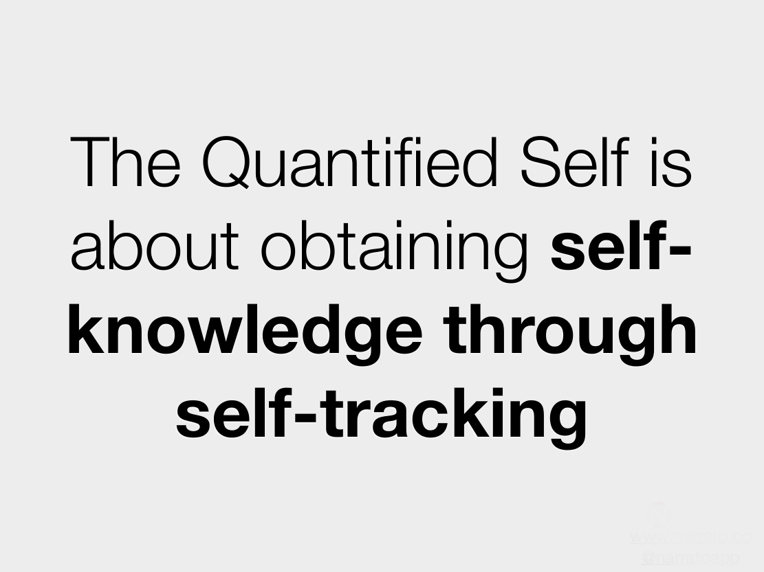

Slide 6
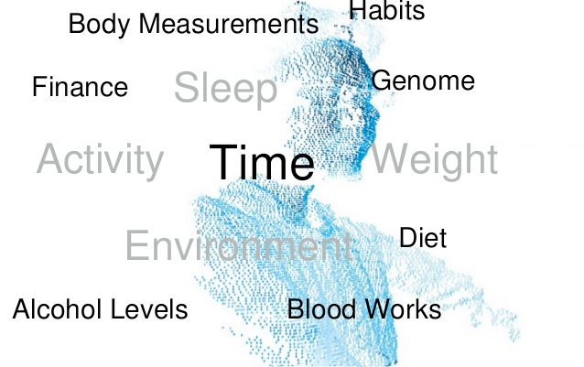
Self-Knowledge through
Self-Tracking

Slide 7





Quantified Self in Education
Learning Analytics in Students
Performance Analytics in Students
Research into Habits (Procrastination¹, etc.)
Performance Analytics in
Teaching Practice (Teachers)
Global Analytics related to
Collective Behavior at school.
(1) Procrastination is the practice of carrying out less urgent tasks in preference to more urgent ones,
or doing more pleasurable things in place of less pleasurable ones, and thus putting off impending
tasks to a later time, sometimes to the "last minute" before a deadline. (Wikipedia)

Slide 8
Background
(Antecedentes)
Plausible Origins
People
Places and Groups
Measures
Technology

Slide 9

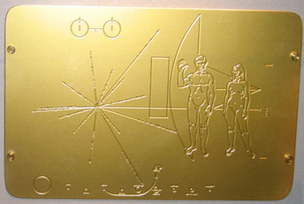
Background
(Antecedentes)
Plausible Origins
Plate sent by NASA on Pioneer missions (1972 Pioneer 10 and 1973 Pioneer 11 spacecrafts).
Is Man the measure of all things in Universe?

Slide 10
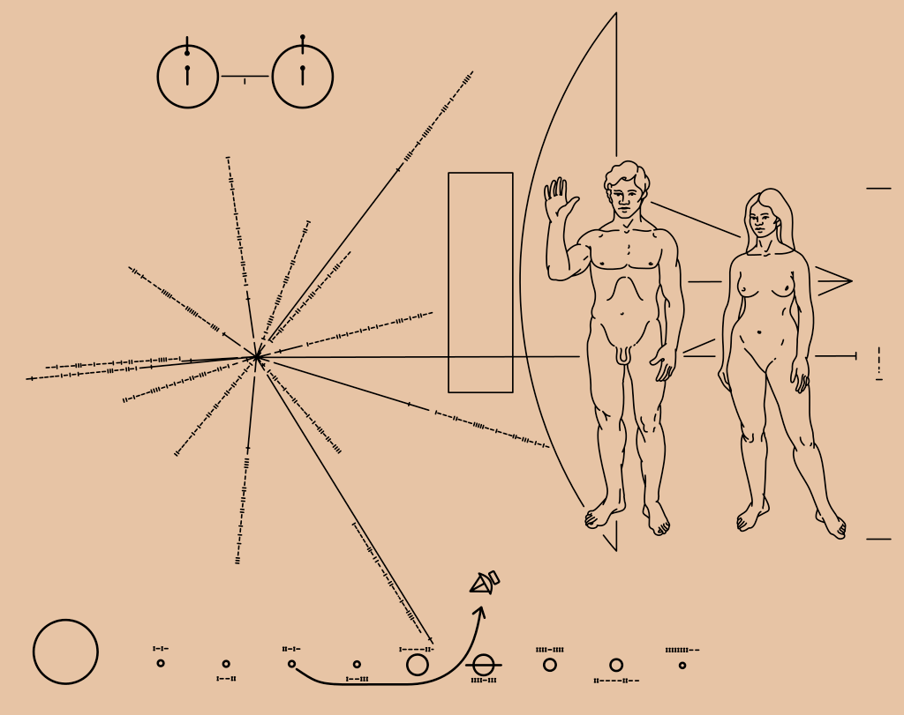
Background
(Antecedentes)
Plausible Origins

Slide 11
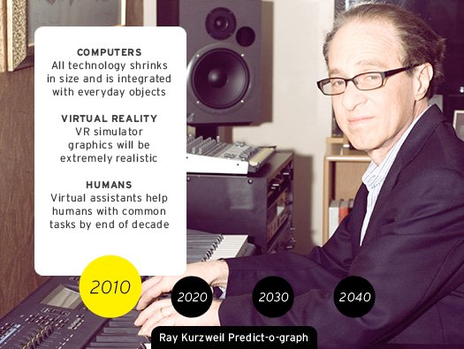
Background
(Antecedentes)
People
Raymond Kurzweil (wikipedia) on Health and aging:
Kurzweil admits that he cared little for his health until age 35, when he was found to suffer from a glucose intolerance, an early form of type II diabetes (a major risk factor for heart disease).
Kurzweil then found a doctor (Terry Grossman, M.D.) who shares his non-conventional beliefs to develop an extreme regimen involving hundreds of pills, chemical intravenous treatments, red wine, and various other methods to attempt to live longer.
Kurzweil was ingesting "250 supplements, eight to 10 glasses of alkaline water and 10 cups of green tea" every day and drinking several glasses of red wine a week in an effort to "reprogram" his biochemistry.[49] Lately, he has cut down the number of supplement pills to 150.[50]
[49]. "Never Say Die: Live Forever". WIRED. Retrieved 15 September 2014.
[50]. CNN.com – Transcripts". Retrieved 15 September 2014.

Slide 12
Background
(Antecedentes)
People
Raymond Kurzweil asserts that in the future, everyone will live forever.[55] In a 2013 interview, Kurzweil said that in 15 years, medical technology could add more than a year to one's remaining life expectancy for each year that passes, and we could then "outrun our own deaths".
Source: Wikipedia.
He has been an extreme advocate of SENS Research Foundation for the successful defeating of aging, and has encouraged acts of donation to hasten their rejuvenation research.[28][56]
Raymond Kurzweil
Born in 1948 (age 67)
[28]. "Will Google's Ray Kurzweil Live Forever?". WSJ. 12 April 2013. Retrieved 15 September 2014.
[55]. "As Humans and Computers Merge ... Immortality? | PBS NewsHour | July 10, 2012". PBS. 2012-07-03. Retrieved 2012-07-11.
[56]. "Ray Kurzweil At SENS 3 | Video". Exponential Times. 2011-08-25. Retrieved 2013-07-28.

Slide 13
Background
(Antecedentes)
People
Raymond Kurzweil asserts that in the future, everyone will live forever.[55] In a 2013 interview, Kurzweil said that in 15 years, medical technology could add more than a year to one's remaining life expectancy for each year that passes, and we could then "outrun our own deaths".
Source: Wikipedia.
He has been an extreme advocate of SENS Research Foundation for the successful defeating of aging, and has encouraged acts of donation to hasten their rejuvenation research.[28][56]
Raymond Kurzweil
Born in 1948 (age 67)
[28]. "Will Google's Ray Kurzweil Live Forever?". WSJ. 12 April 2013. Retrieved 15 September 2014.
[55]. "As Humans and Computers Merge ... Immortality? | PBS NewsHour | July 10, 2012". PBS. 2012-07-03. Retrieved 2012-07-11.
[56]. "Ray Kurzweil At SENS 3 | Video". Exponential Times. 2011-08-25. Retrieved 2013-07-28.

Slide 14
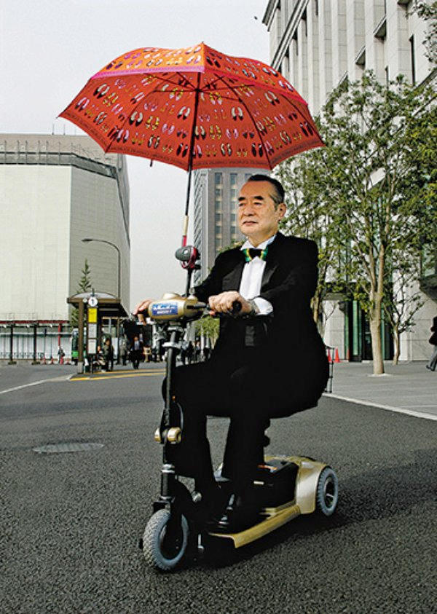
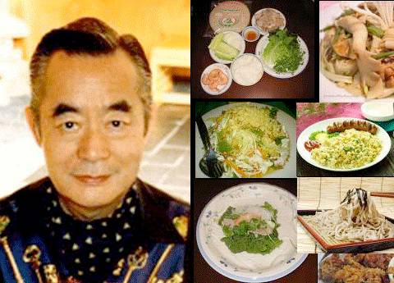
Background
(Antecedentes)
People
In 2005, Yoshiro Nakamatsu was awarded a Prize for Nutrition, for photographing every meal he has ingested during a period of 34 years (and continuing).
Dr. Yoshiro Nakamatsu
Born in 1928 (age 87)

Slide 15
Background
(Antecedentes)
Places and Groups

Slide 16
What kind of measures do people track?

Slide 17
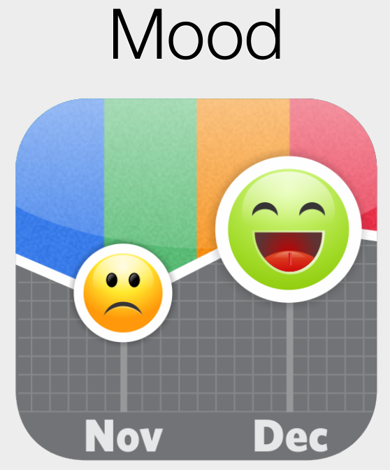





Measures
Source: www.narrato.co
In 2005, Yoshiro Nakamatsu was awarded a Prize for Nutrition, for photographing every meal he has ingested during a period of 34 years (and continuing).
Dr. Yoshiro Nakamatsu
Born in 1928 (age 87)

Slide 18

Measures
Source: www.narrato.co
Did that cup of coffee made you more alert?

Slide 19
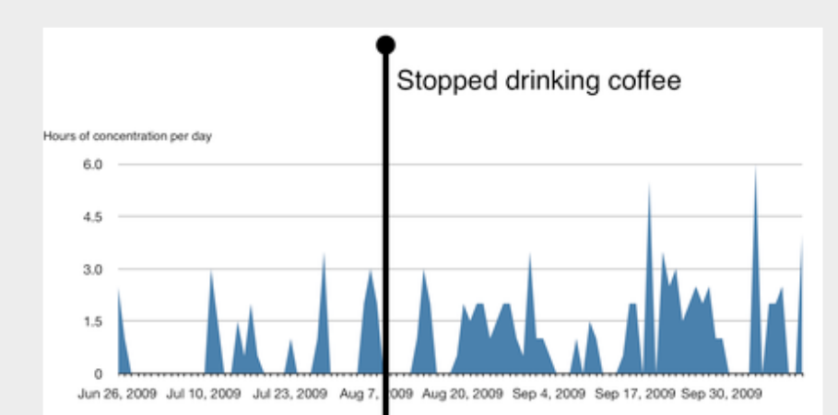
Measures
Source: www.narrato.co
You do not need to guess anymore...

Slide 20
Quantified Self
Technology
(Mobile and Wearables)

Slide 21
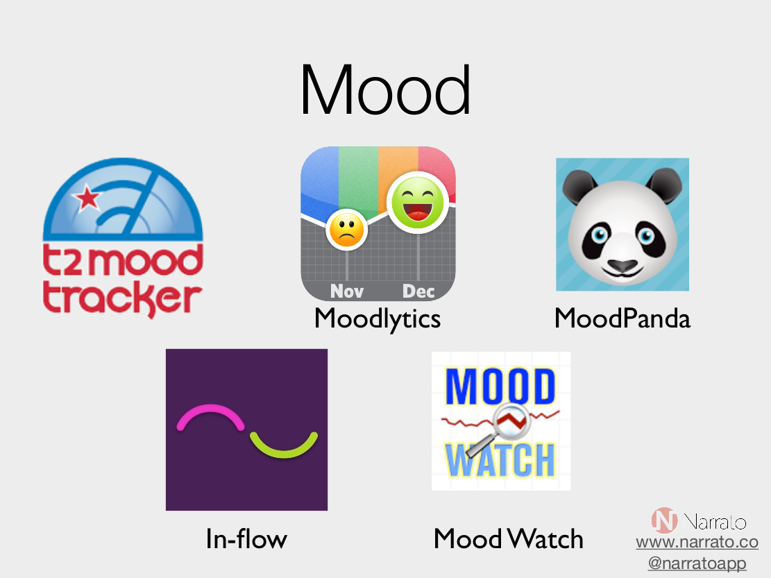

Slide 22
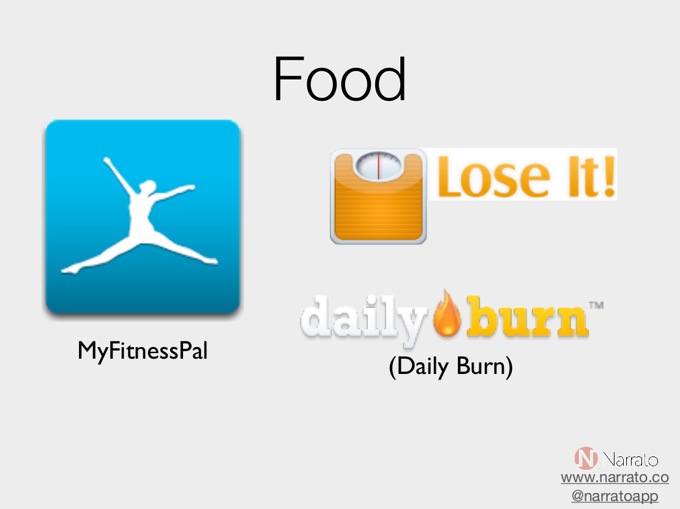

Slide 23
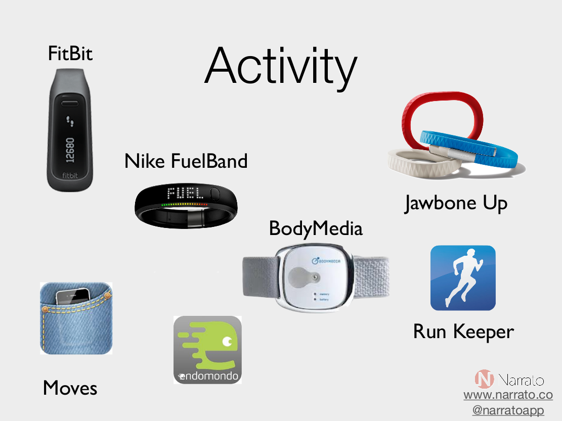

Slide 24
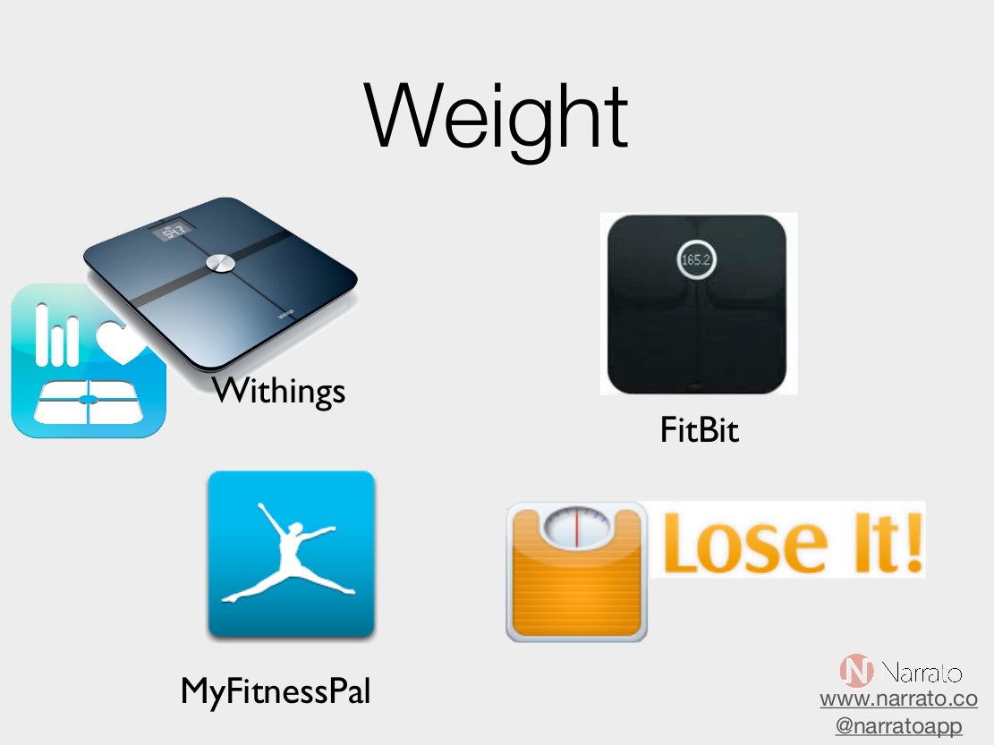

Slide 25
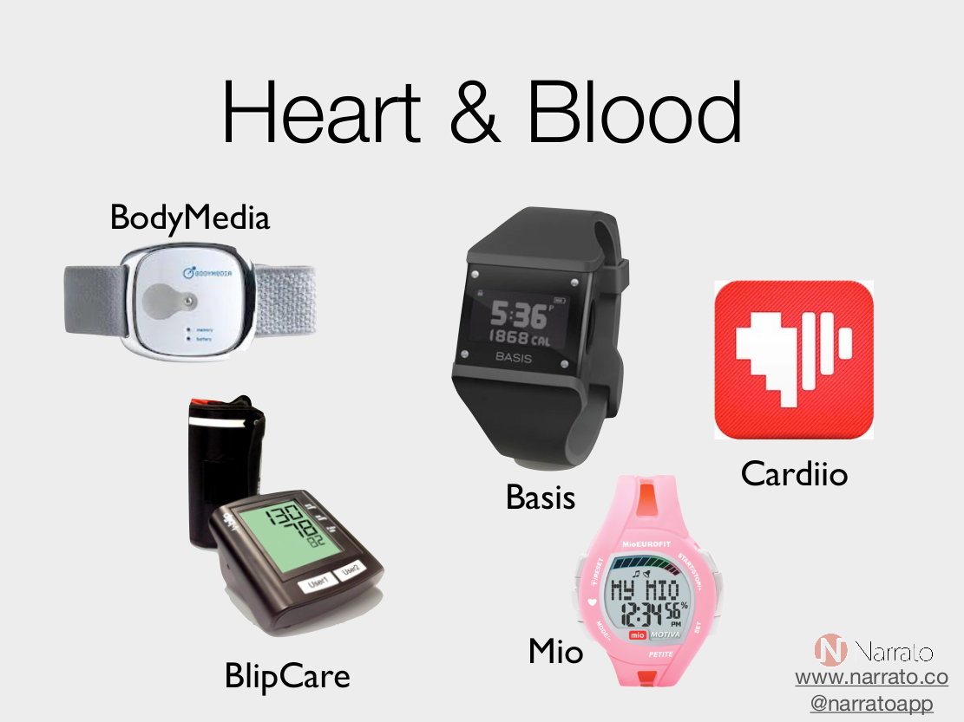

Slide 26
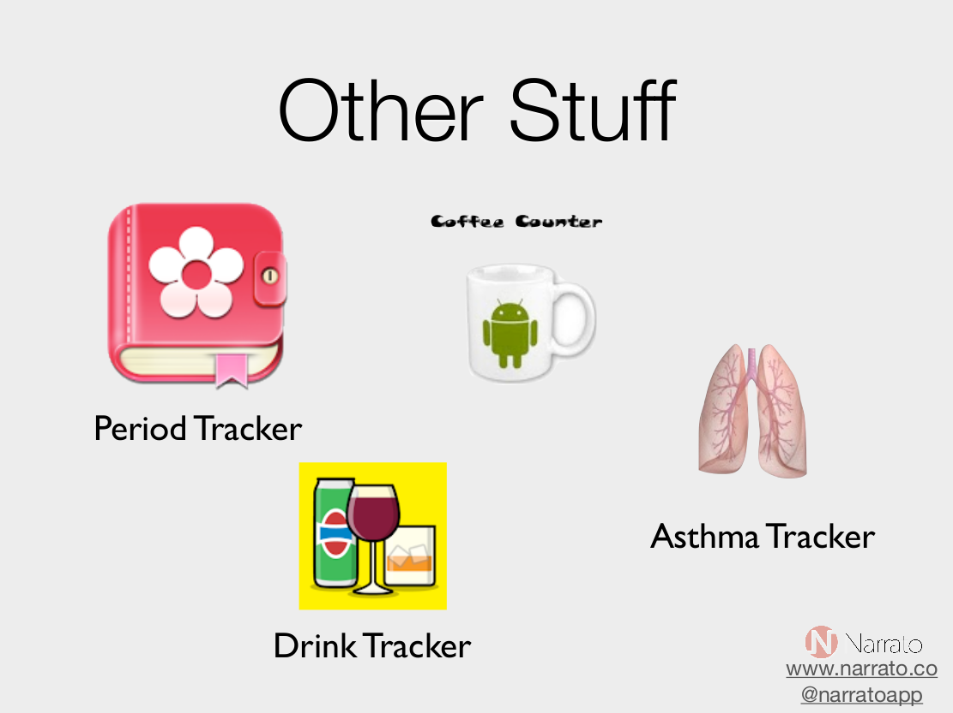

Slide 27
Example
Using the “FitBit"
https://www.youtube.com/watch?v=yoaRwJxRg8I

Slide 28
Learning
Analytics
Where do QS and Learning Analytics meet?
The Quantified Self in
Education

Slide 29
Learning Analytics
"The measurement, collection, analysis and reporting of data about learners and their contexts, for purposes of understanding and optimizing learning and the environments in which it occurs²”
(2). As expressed in Call for Papers of the 1st. International Conference on Learning
Analytics & Knowledge (LAK 2011).

Slide 30
Differents interest on
Learning Analytics³
Reflect on achievements and patterns of behaviour for individual learners.
Discovering predictors for students requiring extra support and attention.
Help teachers plan different interventions with individuals and groups.
Seeking to improve current courses or develop new curriculum offerings.
For administrators taking decisions on matters such as marketing and recruitment or efficiency and effectiveness measures.
(3). Powell, Stephen, and Sheila MacNeil. Institutional Readiness for Analytics .A
Briefing Paper. CETIS Analytics Series. JISC CETIS, December 2012. h
ttp://publications.cetis.ac.uk/wp-content/uploads/2012/12/Institutional-Readiness-for-Analytics-Vol1-No8.pdf

Slide 31
The State of
Learning Analytics⁴
There are questions regarding the optimization of systems to support learning (for example: how we can know whether a student is engaged/understanding?)
Increasing focus on evidencing progress and professional standards for accountability of learning systems.
Teacher contribution in the analytics - given that they are associated with accountability.
Increasing emphasis is placed on the pedagogic qualities or properties of learning analytics.
Increased economic desire to improve engagement in online education for the deliverance of high quality - affordable – education.
Increasing interest in 'big data' for business intelligence.
The rise of online education focused around Virtual Learning Environments (VLEs), Content Management Systems (CMSs), and Management Information Systems (MIS) for education.
(4). Ferguson, Rebecca. The State of Learning Analytics in 2012: A Review and Future Challenges.Technical Report. Knowledge Media Institute: The Open University, UK, 2012.http://kmi.open.ac.uk/publications/pdf/kmi-12-01.pdf

Slide 32
Techniques and Methods for
Learning Analytics
Prob and Statistics – probability distributions and hypothesis testing.
Business Intelligence - enabling data access and summarising performance indicators.
Web analytics - exploration of student trajectories through learning resources (courses, materials, etc.).
Operations research - optimization for maximising objectives through the use of mathematical models and statistical methods.
Machine learning - techniques built on data mining and AI methods are capable of detecting patterns in data. In learning analytics such techniques can be used for intelligent tutoring systems,for example.
Social Network Analysis - SNA analyses relationships between people by exploring implicit (e.g. interactions on forums) and explicit (e.g. 'friends' or 'followers') ties online and offline.
Information visualization - visualisation is an important step in many analytics for making sense of data at hand.

Slide 33
Simple Model for
Learning Analysis
Quantified Self
Variables
Learning
Analysis
“Proxy"
Random
Variables
Analysis outcomes:
Prediction, for example to identify students 'at risk' in terms of
drop out or course failure.
Personalization & Adaptation, to provide students with tailored learning pathways, or assessment materials.
Intervention purposes, providing educators with information to intervene to support students.
Information visualization, learning through data visualization tools.

Slide 34
Some examples of
Quantified Self Data

Slide 35
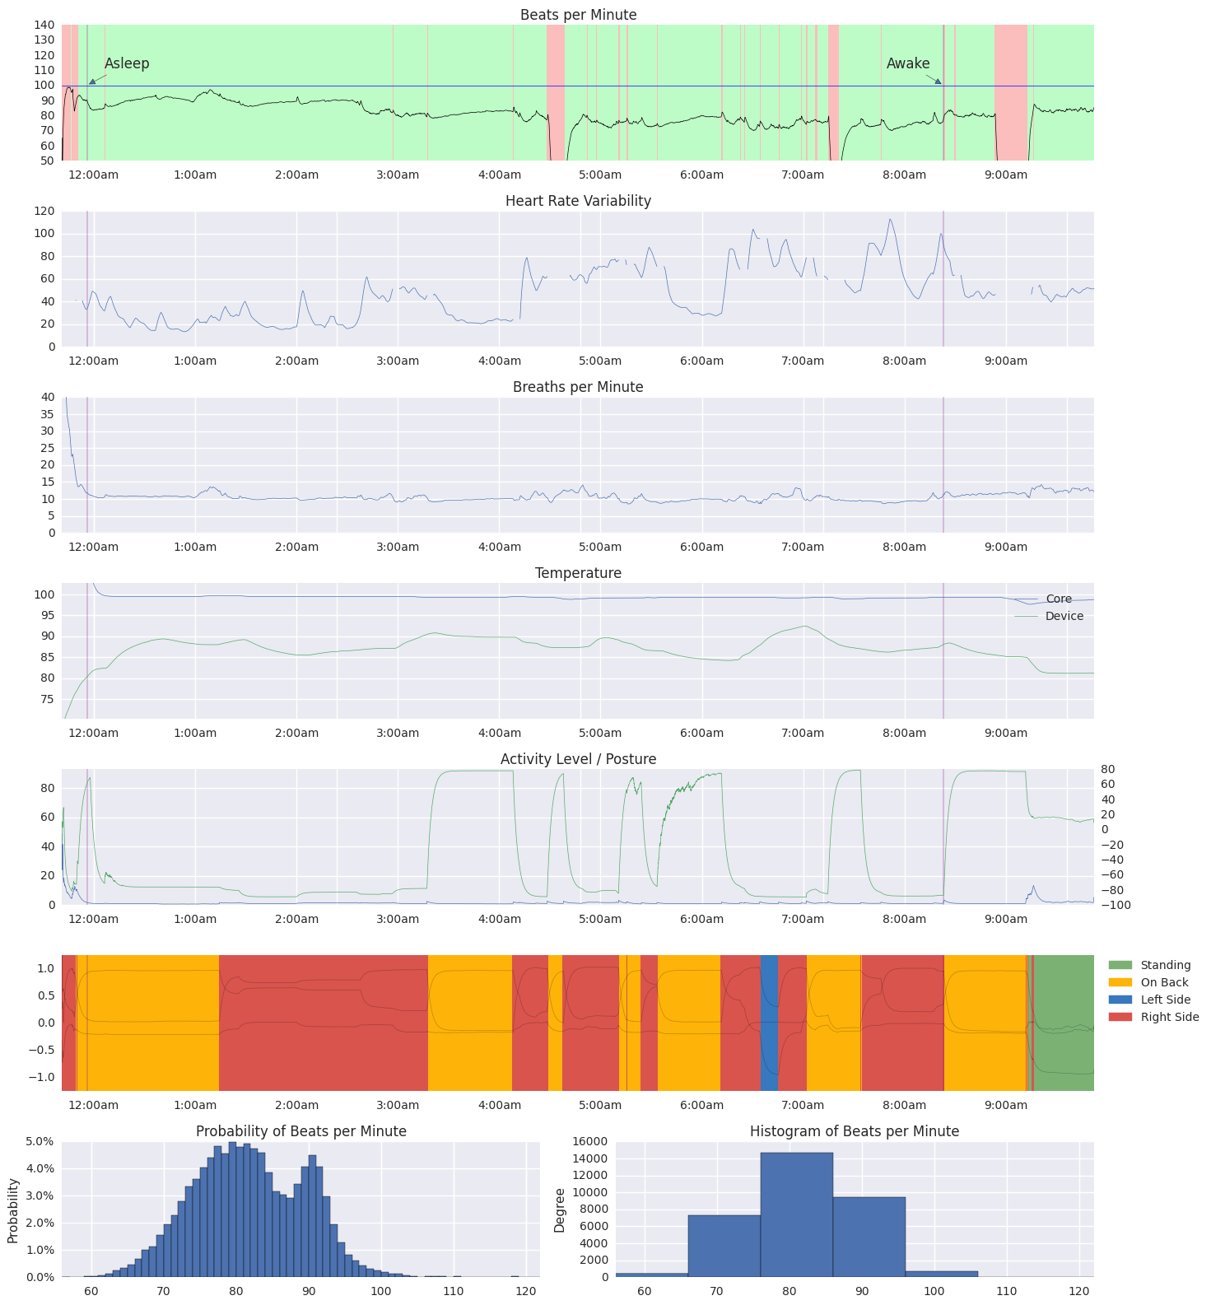
Some examples of
Quantified Self Data
Source: http://quantifiedself.com/wp-content/uploads/2015/07/Beau.png
From: http://quantifiedself.com/data/ section: What We Are Reading
2015 QS Visualization Gallery: Part 1. Posted on July 9, 2015 by Ernesto Ramirez

Slide 36
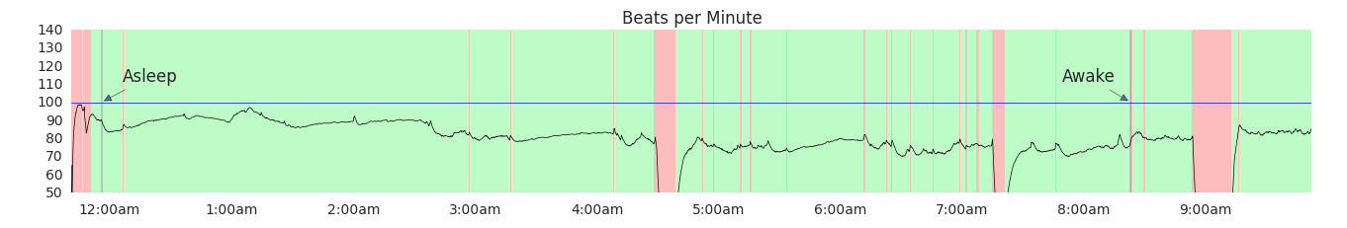
Some examples of
Quantified Self Data

Slide 37
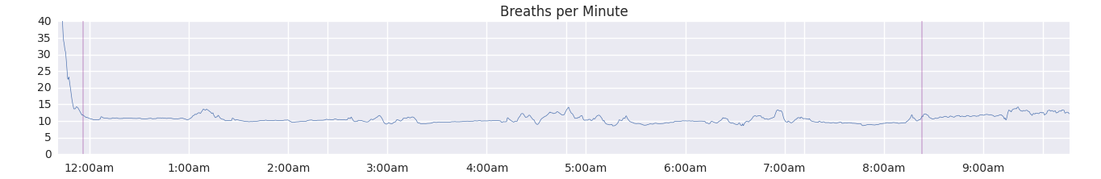
Some examples of
Quantified Self Data

Slide 38
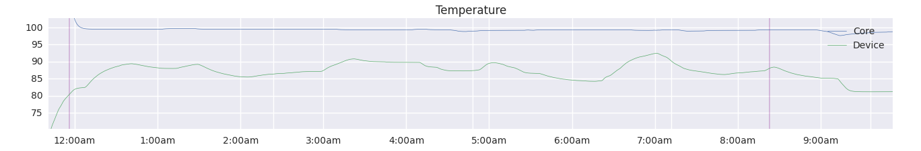
Some examples of
Quantified Self Data

Slide 39
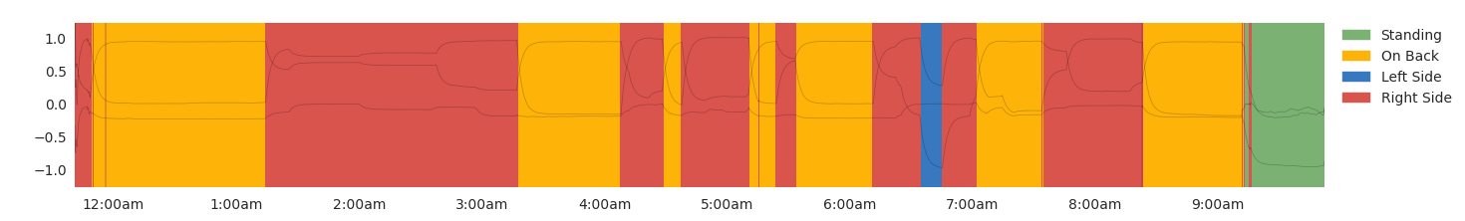
Some examples of
Quantified Self Data

Slide 40
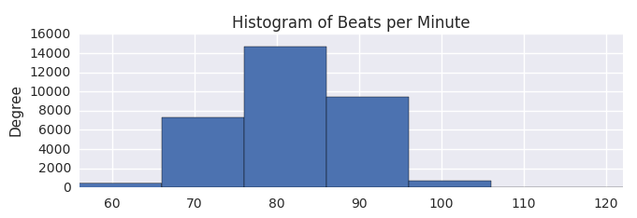
Some examples of
Quantified Self Data

Slide 41
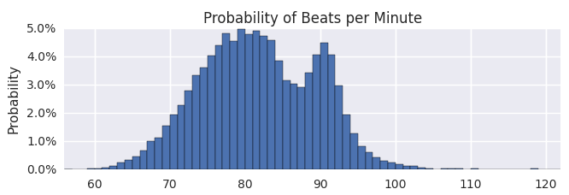
Some examples of
Quantified Self Data

Slide 42
Toolbox for the Data Scientist

Slide 43







Toolbox for the Data Scientist

Slide 44
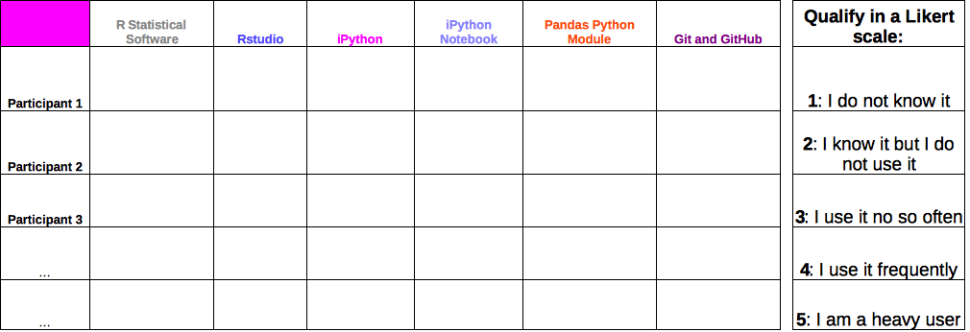
Analysis Lab 1

Slide 45
Quantified Self data repositories
(the problem of access)

Slide 46
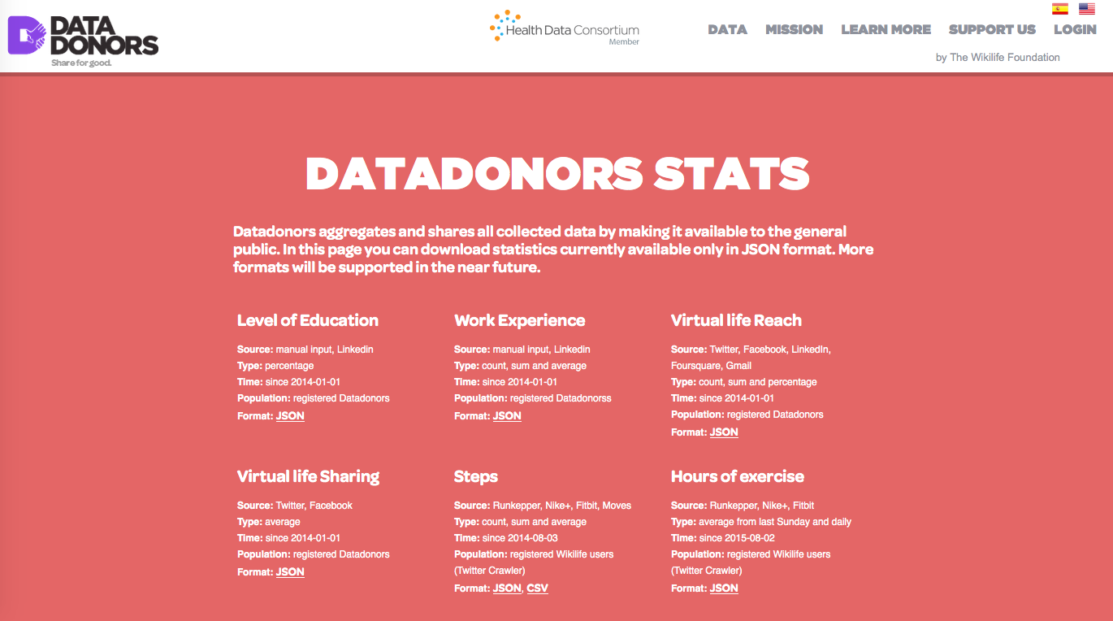
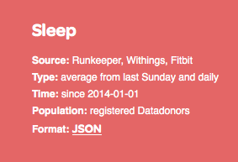

Slide 47
Analysis Lab 2
Time Domain
Frequency Domain
Probability Domain
Sampling from a Discrete Probability Distribution

Slide 48
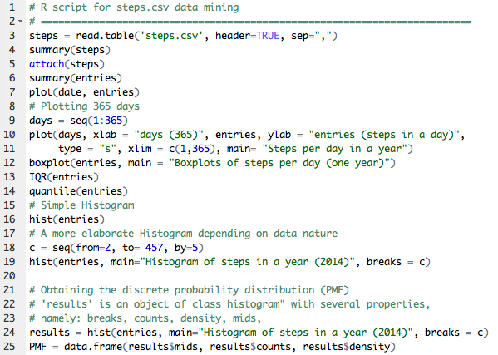
Analysis Lab 2
Time Domain
Frequency Domain
Probability Domain
Sampling from a Discrete
Probability Distribution

Slide 49
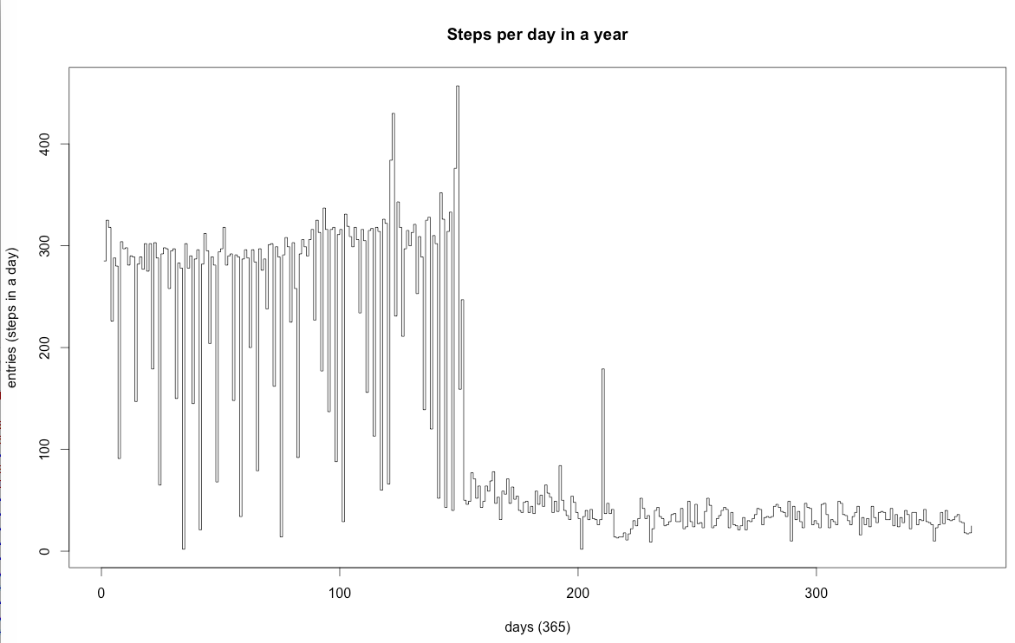
Analysis Lab 2
Time Domain

Slide 50
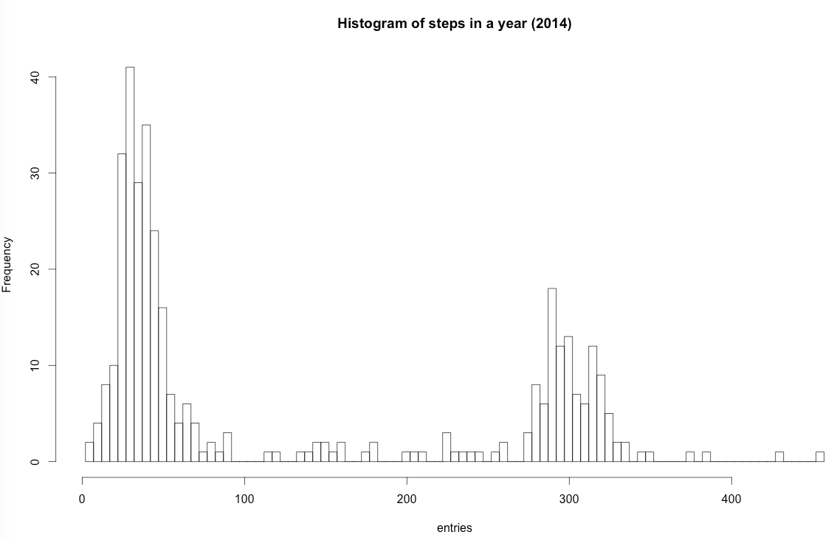
Analysis Lab 2
Frequency Domain

Slide 51
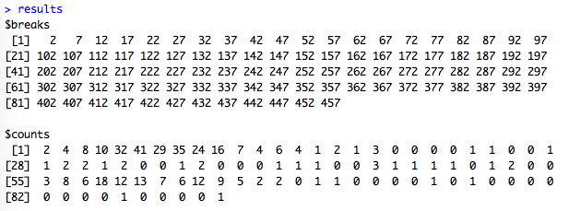
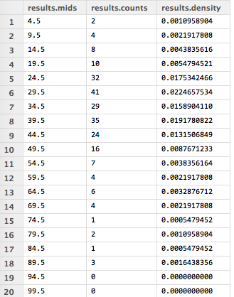
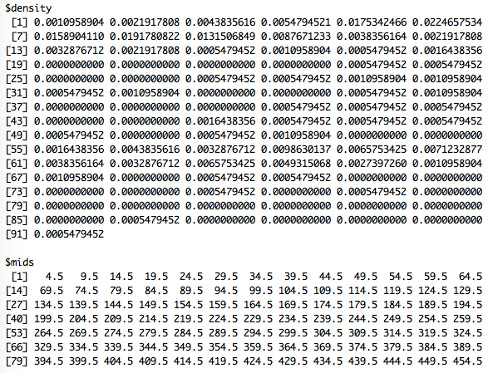
Analysis Lab 2
Probability
Domain
92
91
91
91
...

Slide 52
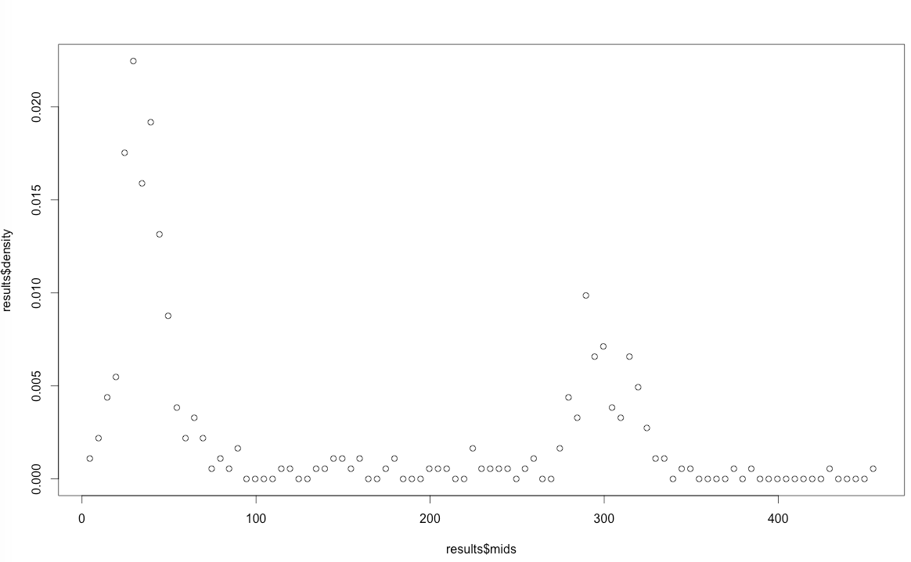
Analysis Lab 2
Probability Domain

Slide 53
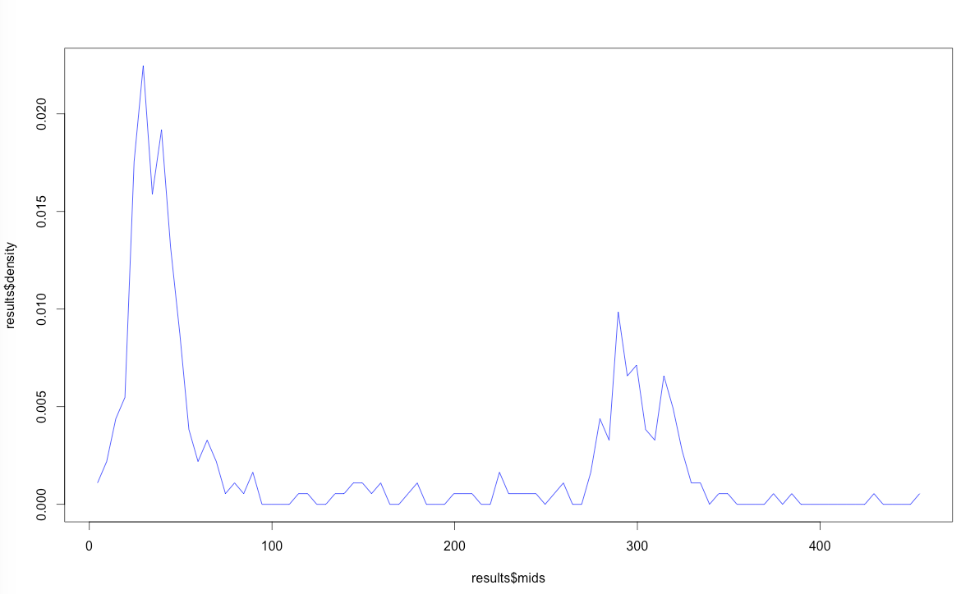
Analysis Lab 2
Probability Domain

Slide 54
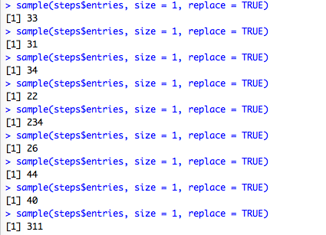
Analysis Lab 2
Sampling from a
Discrete Probabilty
Distribution
Samples entries (number of steps)
at random with equal probability

Slide 55
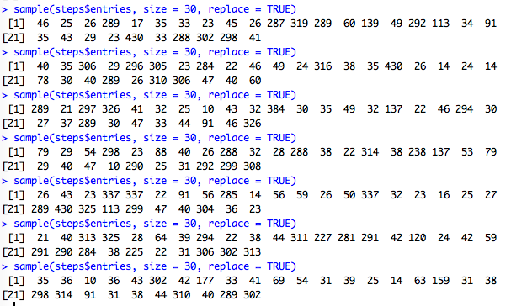
Analysis Lab 2
Sampling from a
Discrete Probabilty
Distribution
Obtaining Samples of 30 entries
at random with equal probability

Slide 56
Analysis Lab 3

Slide 57
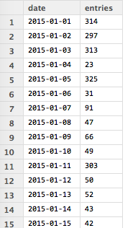
Analysis Lab 3
Sampling from a
Discrete Probabilty
Distribution
How do we simulate a (new)
complete year from “steps" dataframe?

Slide 58
Optional subjects
Conclusions
Further work

